Slide 1

Progyny Assessment
26th July 2024
By Aakash Mohikar

Slide 2
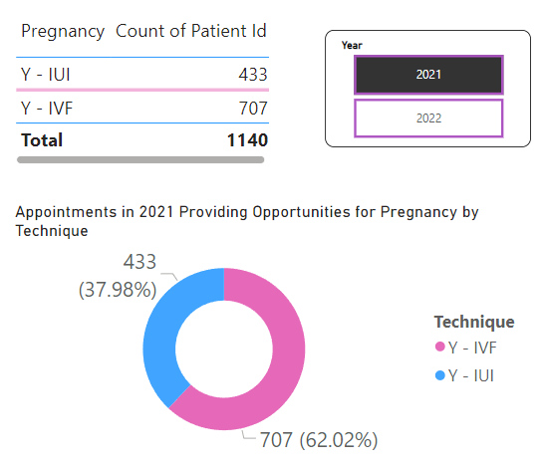
How many appointments occurred in 2021 in which members had an opportunity to achieve pregnancy?
In 2021, there were a total of 1140 appointments where members had an opportunity to achieve pregnancy. This includes 433 appointments for IUI and 707 appointments for IVF.
Figure 1: Appointments in 2021 Providing Opportunities for Pregnancy by Technique

Slide 3
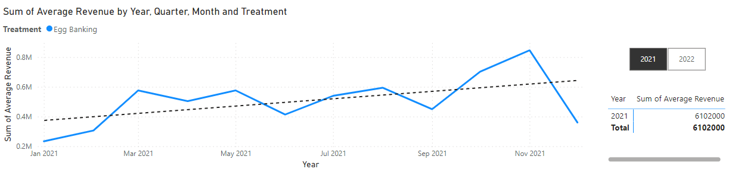
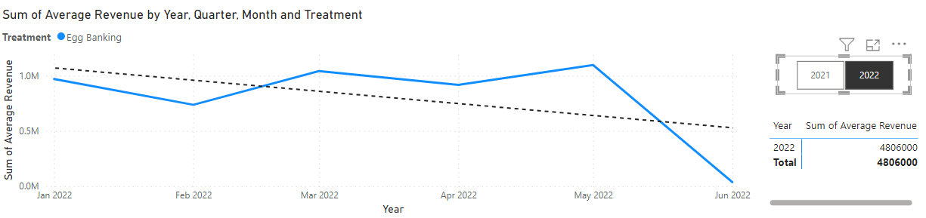
2. We are not achieving our 2022 revenue goals for Egg Banking. What insights can you draw from the data?
2021:
4,721 appointments
70% completion rate (3,289 completed treatments)
2022 (Q1, Q2):
4,288 appointments
30% completion rate (1,278 completed treatments)
Observations:
Lower completion rate in 2022 suggests:
Higher cancellation rates
Treatment delays
Incomplete records for later part of the year
Absence of data for last two quarters may skew results
Figure 2: Sum of Average Revenue in 2021 for Egg Banking
Figure 3: Sum of Average Revenue in 2022 for Egg Banking
Notes:
Sfesdfsdf

Slide 4
Insights
Increase in Initial Consultations:
There is a significant increase in the number of initial consultations in Q1 2022 (796) compared to any quarter in 2021. This increase suggests that marketing or outreach efforts may be driving more potential clients to explore fertility options.
Figure 4: Count of Total Treatment Appointments made per quarter

Slide 5
Insights
Fluctuations in Egg Banking Treatments:
While there was an increase in Egg Banking treatments in Q1 2022 (153) compared to Q4 2021 (106), Q2 2022 saw a decrease to 114.
This fluctuation indicates that despite an increase in initial consultations, the conversion rate from consultation to Egg Banking treatment is inconsistent.
Figure 4: Count of Total Treatment Appointments made per quarter

Slide 6
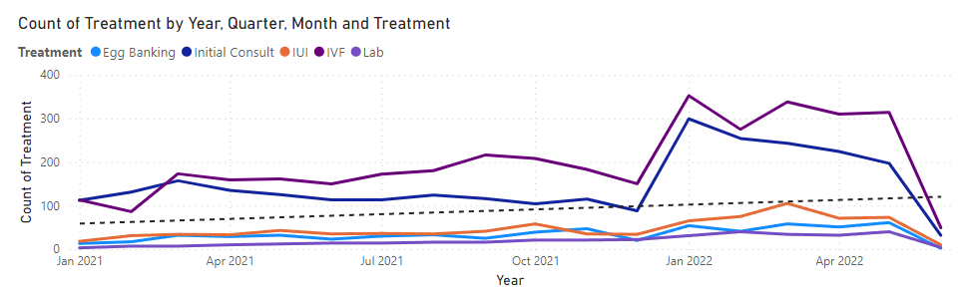
Insights
Strong Performance in Other Treatments:
IVF treatments show strong numbers, especially in Q1 2022 (965), indicating high demand and possibly a stronger preference or recommendation for IVF over Egg Banking.
The increase in IVF treatments in Q1 and Q2 of 2022 likely resulted from:
Pandemic Delays
Increased Awareness
Financial Incentives
Consultation Influence
Figure 5: Count of Treatment Appointments by Year and Month

Slide 7
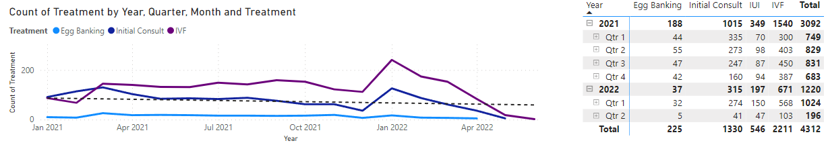
Insights on Completed Treatments
Egg Banking:
Completed egg banking treatments are significantly lower than total egg banking appointments
Initial Consults:
Significant drop-off from initial consults to completed treatments
IVF:
Number of completed treatments closer to total appointments compared to other treatments
Figure 6: Count of Completed Treatments by Year and Month

Slide 8
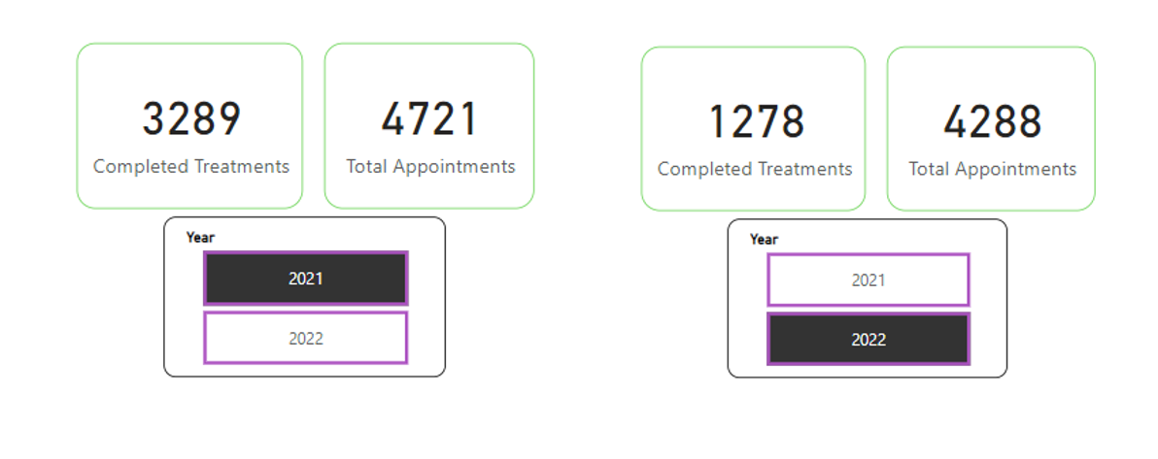
Decrease in Overall Treatment Completion
Figure 7: Total appointments vs Completed Treatments per year

Slide 9

Potential Issues and Strategy Recommendations
Conversion Rate:
The conversion rate from initial consultations to Egg Banking treatments is inconsistent and appears to drop significantly in Q2 2022. This could indicate issues in the consultation process or patient follow-up.
Recommendation: Improve patient follow-up procedures post-consultation, ensuring potential patients are well-informed and supported in making decisions about Egg Banking.
Patient Preferences and Counseling:
The high numbers in IVF treatments suggest patients might be more inclined or better counseled towards IVF rather than Egg Banking.
Recommendation: Evaluate the consultation process to ensure that Egg Banking is presented as a viable and appealing option where appropriate.
Notes:
Personalized communication and addressing patient concerns may improve conversion rates. This could include follow-up calls, emails, and additional informational sessions.
This might include highlighting specific benefits of Egg Banking or addressing misconceptions about the procedure.

Slide 10

Potential Issues and Strategy Recommendations
Marketing and Lead Generation:
Evaluate the effectiveness of marketing campaigns and lead sources. Are you attracting the right audience? Are leads from certain sources less likely to convert to patients?
Pricing and Financial Options:
Review the pricing of the initial consultation and subsequent treatments. Offer flexible financial options or payment plans to make treatments more accessible.

Slide 11
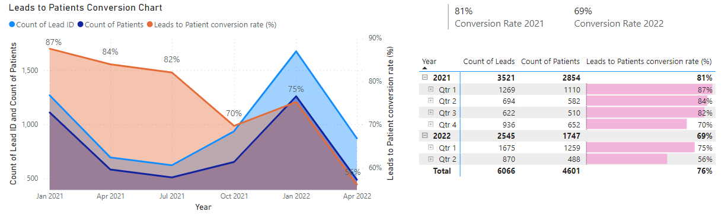
3. Q3 2022 Conversion Rate Improvement: Measuring Lead to Patient Conversion
Insights
Decreasing Conversion Rates: The drop in conversion rates from 81% in 2021 to 69% in 2022, and particularly to 56% in Q2 2022, is concerning.
Quarterly Variability: Q1 2021 and Q1 2022 showed relatively high conversion rates, suggesting potential seasonal factors or effective strategies during these periods.
Performance Improvement Areas: Focus should be placed on understanding why the conversion rate dropped in Q2 2022 and how to replicate the success factors from the higher-performing quarters.
Figure 9: Leads to Patients Conversion Chart
Figure 10: Summary of Leads to Patients Conversion rate

Slide 12
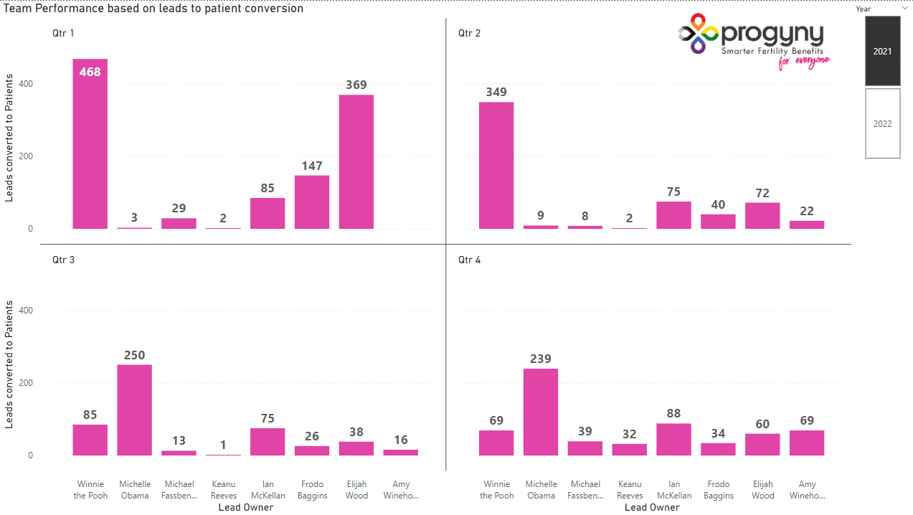
2021 Quarterly Team Performance
Figure 11: Team Performance based on leads to patients’ conversion for 2021 (Top 8 Lead Owners)

Slide 13
3. Q3 2022 Conversion Rate Improvement: Measuring Lead to Patient Conversion
Strategies to Increase Conversion Rates
Review and Optimize Lead Nurturing: Analyze the lead nurturing process to identify bottlenecks and areas for improvement.
Training and Support for Teams: Ensure the team is well-trained and supported to handle leads effectively.
Customer Feedback: Collect feedback from leads who did not convert to understand their concerns and address them.
Seasonal Campaigns: If there are seasonal trends, create targeted campaigns to boost conversions during slower periods.
Figure 12: Summary of Leads to Patients Conversion rate

Slide 14
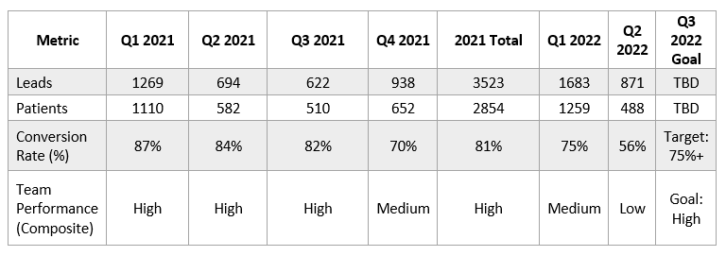
3. Q3 2022 Conversion Rate Improvement: Measuring Lead to Patient Conversion

Slide 15
Conclusion
Understand the Drop:
Investigate reasons for the Q2 2022 conversion rate decline.
Implement Strategies:
Address identified issues with targeted solutions.
Continuous Monitoring:
Regularly track performance to ensure improvements.
Notes:
- **Consultation Quality:**
- Inconsistent or unclear information provided during consultations.
- **Patient Follow-Up:**
- Inadequate or infrequent follow-up communication with potential patients.
- **Patient Concerns:**
- Unaddressed concerns or questions from patients post-consultation.
- **Scheduling Issues:**
- Difficulty in booking follow-up appointments or treatments.
- **Marketing and Outreach:**
- Ineffective marketing strategies leading to unqualified leads.
- **Economic Factors:**
- Patients facing financial constraints or uncertainties.

Slide 16

Thank you for listening

